Slide 1

EXPERIMENTAL EDUCATION ENGINEERING
(ExEED)
PRODUCT BASED LEARNING
E-HEALTH ADVISOR
S. No | NAME | ROLL No | BRANCH & SECTION
1 | Y.CHITTY BABU | 23955A0509 | CSE-B
2 | T.ESHWAR | 23955A0510 | CSE-B
3 | E.MITHEEL | 23955A0513 | CSE-B

Slide 2


Slide 3
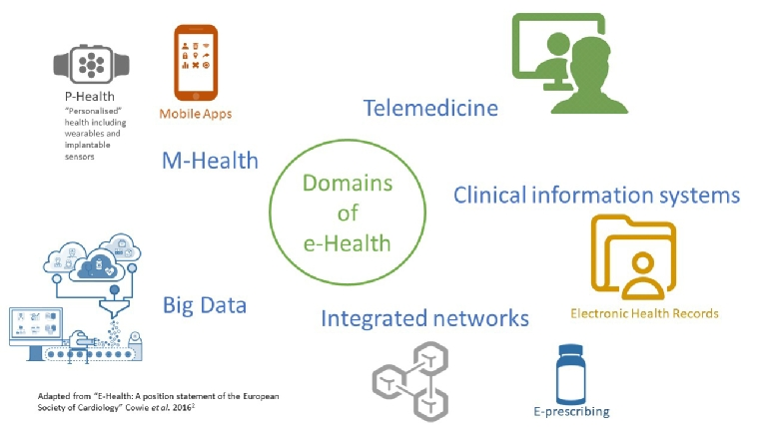
Introduction to E-Health Adviser
What is E-Health?: Digital health solutions that enable remote healthcare services.
Includes telemedicine, health data management, and virtual consultations.
Importance of E-Health:
Provides healthcare access to rural and underserved populations. Reduces healthcare costs and improves efficiency.
Notes:
Image source: https://www.escardio.org/Journals/E-Journal-of-Cardiology-Practice/Volume-18/what-is-e-health

Slide 4
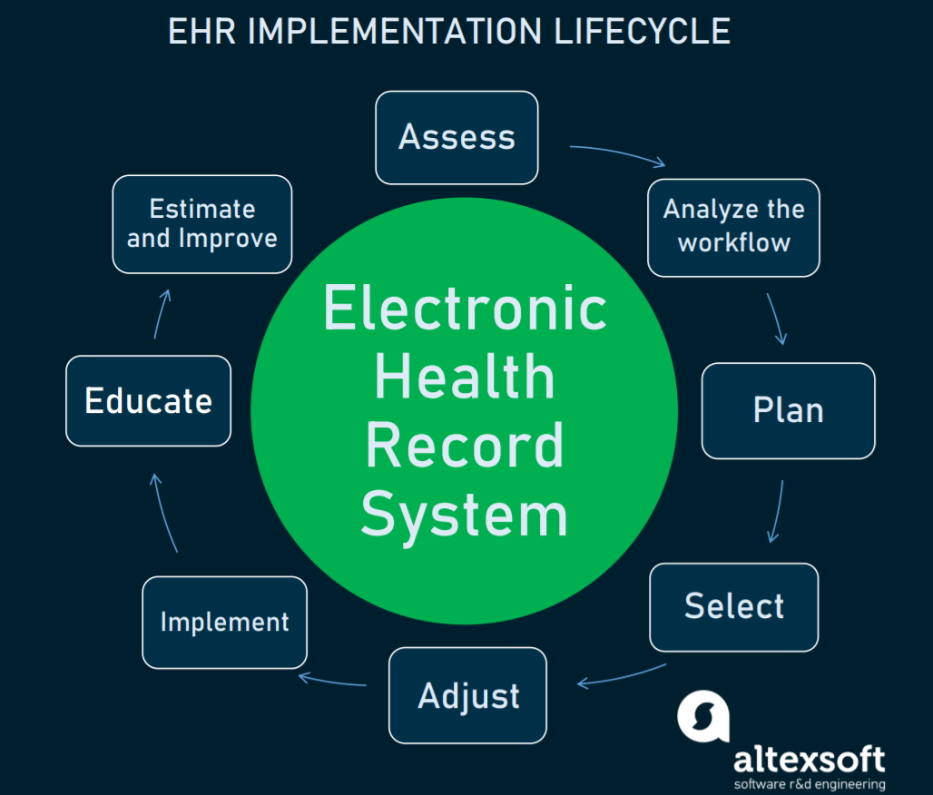
Objectives of E-Health Adviser
Improved Access
Connects patients with specialists regardless of location.
Convenience
Virtual consultations save time and reduce the need for travel.
Cost-Effective
Reduces hospital readmissions and in-person visits.
Timely Medical Support
Allows for faster diagnosis and real-time support.
.
Notes:
Image source: https://template.mapadapalavra.ba.gov.br/en/ehr-implementation-plan-template.html

Slide 5
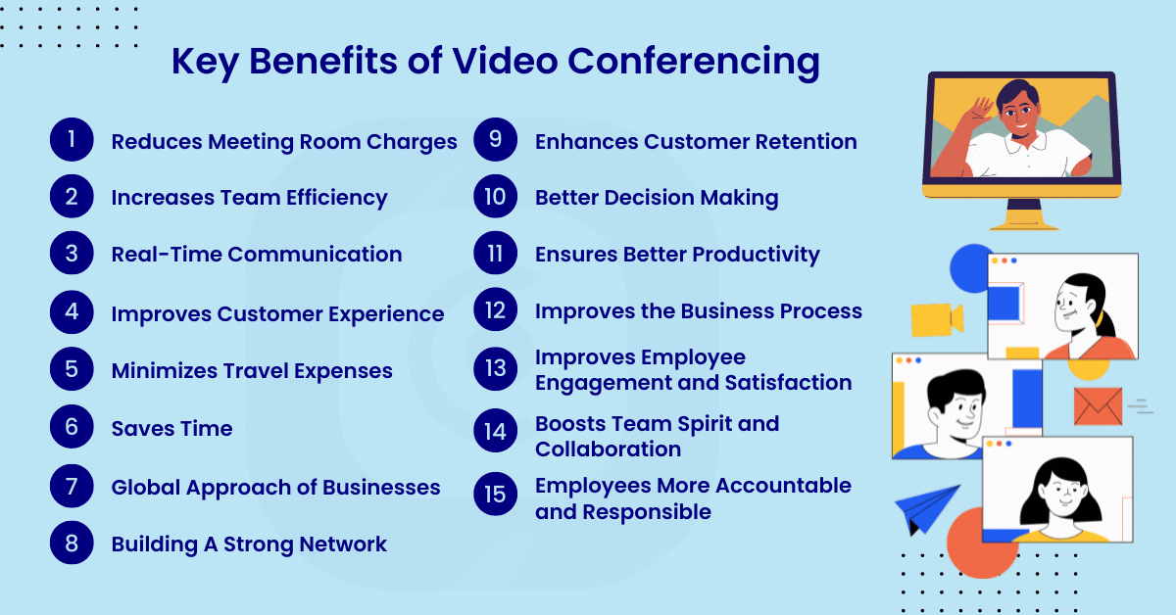
Benefits of Live Video Conferencing
Live video conferencing facilitates real-time communication between patients and providers.
It reduces travel time and costs for patients seeking medical advice.
It Uses the Zoom features.
Notes:
Image source: https://www.oneclickitsolution.com/blog/benefits-of-video-conferencing/

Slide 6

Target Audience
E-Health Adviser caters to patients of all ages seeking healthcare advice.
It is particularly beneficial for individuals with mobility issues or chronic conditions.
Healthcare providers looking to expand their practice can also benefit from this service.
Notes:
Image source: https://cashier.mijndomein.nl/en/target-audience-template.html

Slide 7

Technology and Infrastructure
A stable internet connection is paramount for effective video consultations.
Robust cybersecurity measures protect patient data and privacy.
Reliable software solutions support smooth operation and user experience.
Notes:
Image source: https://workplays.ph/blog/opt-coworking-space/

Slide 8
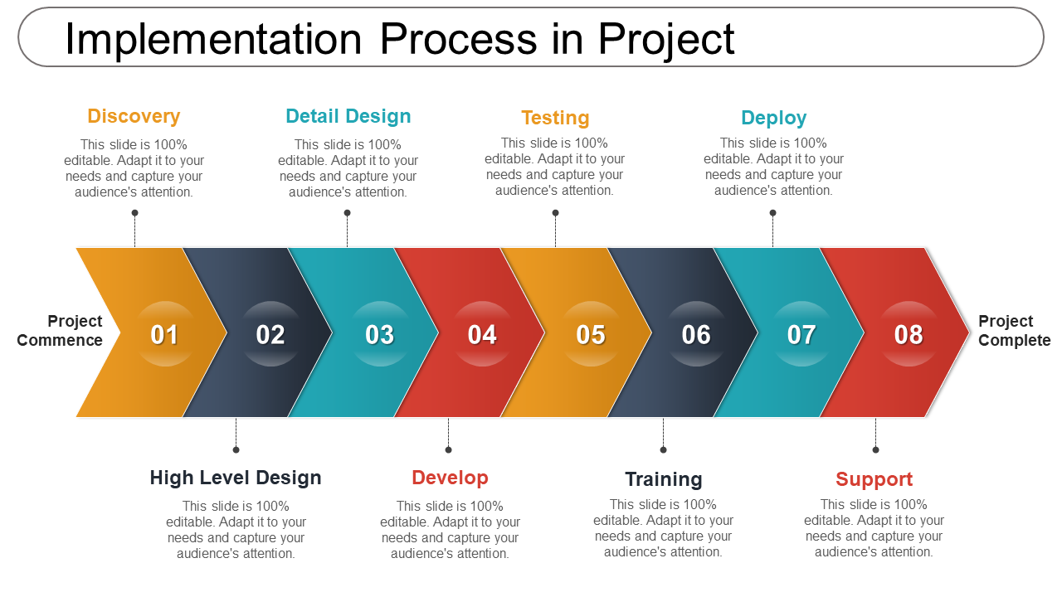
Implementation Steps
Assess the technical requirements and infrastructure needed for the service.
Train healthcare providers on using video conferencing tools effectively.
Launch a pilot program to evaluate the effectiveness and make necessary adjustments.
Notes:
Image source: https://www.slideteam.net/blog/top-7-project-implementation-plan-templates

Slide 9

Challenges in Implementation
Technical issues such as connectivity problems can disrupt consultations.
Some patients may lack the necessary technology or skills to engage with e-health services.
Regulatory hurdles and reimbursement policies can complicate service delivery.
Notes:
Image source: https://www.coeosolutions.com/network-and-connectivity-issues

Slide 10
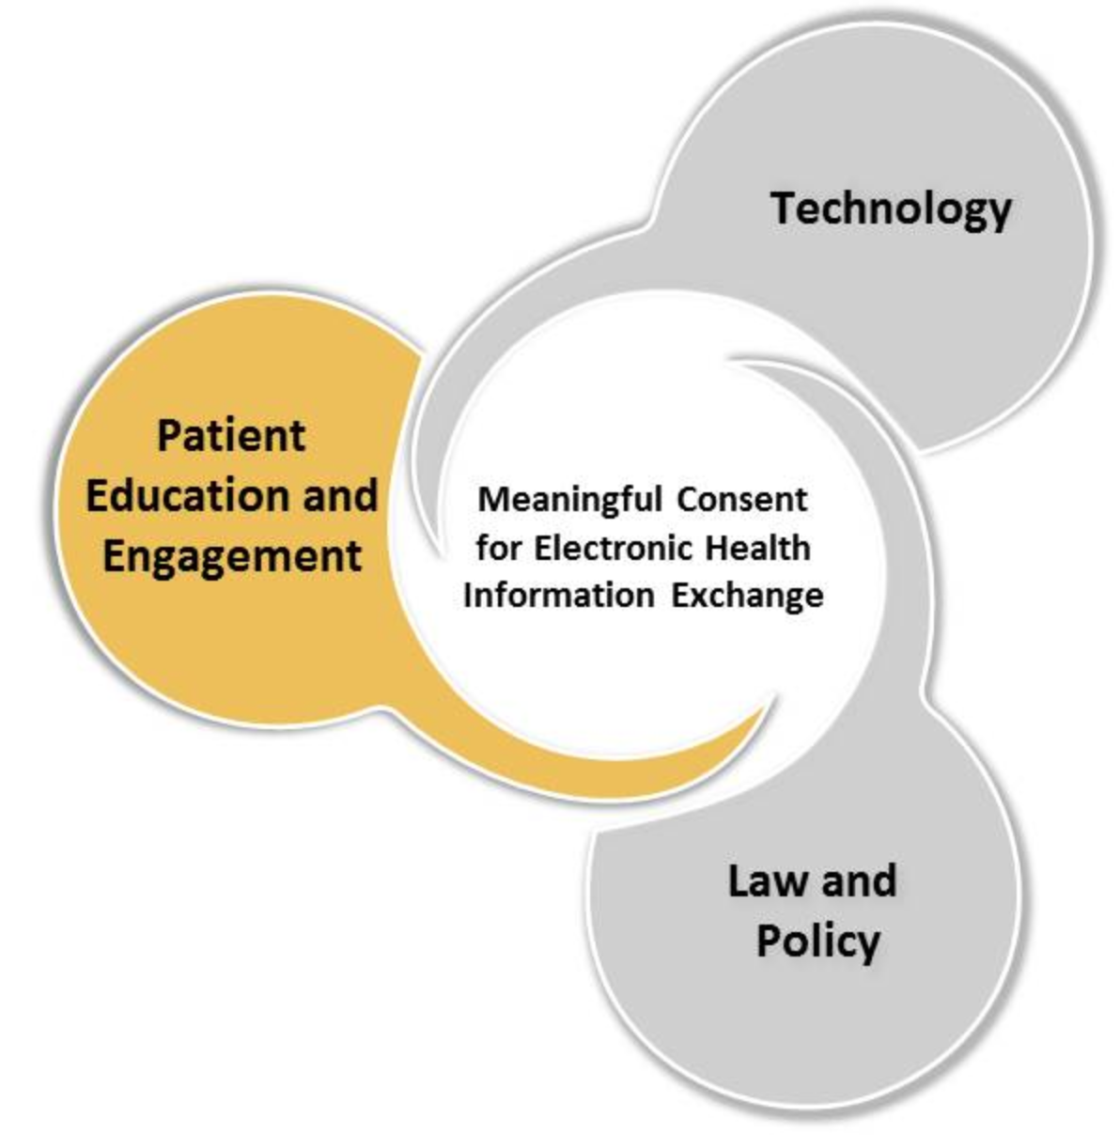
Patient Education and Engagement
Providing educational resources can help patients understand the e-health process.
Encouraging feedback from patients can lead to service improvements.
Engaging patients through reminders and follow-ups enhances their experience.
Notes:
Image source: https://www.healthit.gov/topic/patient-education-and-engagement

Slide 11
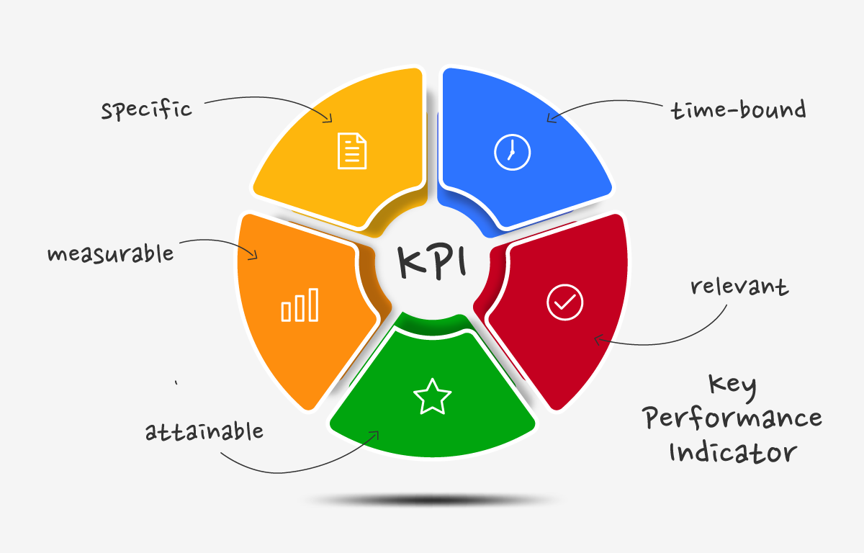
Measuring Success
Key performance indicators (KPIs) should be established to assess service effectiveness.
Patient satisfaction surveys provide valuable insight into service quality.
Monitoring consultation outcomes can help refine the service further.
Notes:
Image source: https://exoaevwea.blob.core.windows.net/vrq1xqtycm/key-performance-indicators-kpis.html

Slide 12
Case Studies and Best Practices
Successful implementation in various healthcare settings showcases diverse applications.
Best practices from experienced providers can guide new adopters.
Sharing success stories can encourage wider acceptance of e-health services.
Notes:
Image source: https://6tdgg.wceacses.org/

Slide 13
Conclusion
E-Health Adviser with live video conferencing represents a significant advancement in healthcare.
It addresses key challenges faced by both patients and providers in accessing care.
The ongoing evolution of technology will further enhance the potential of e-health services.
Notes:
Image source: https://www.escardio.org/Journals/E-Journal-of-Cardiology-Practice/Volume-18/what-is-e-health

